Slide 1

Graph Coloring and Vertex Cover Problems
Data Structure | Graph
Course: Data Structure | Chapter: Graph | Bachelor of Engineering
DISCOVER · LEARN · EMPOWER
Notes:
Welcome everyone to today's lecture on Graph Coloring and Vertex Cover. These are two of the most critical optimization problems in graph theory. We will explore how to assign colors to vertices and select minimum vertices to cover edges. These concepts are foundational for scheduling and resource allocation.

Slide 2
Course Outcomes
SLIDE 2 / 14
Course Outcome
CO | BT LEVEL | DESCRIPTION
CO1 | BT1 | Understand and apply basic data structures, algorithms, complexity analysis, ADTs, arrays and linked lists.
CO2 | BT2 | Apply and implement stacks and queues in problem-solving.
CO3 | BT3 | Analyse and apply searching, sorting, and hashing techniques.
CO4 | BT4 | Construct and apply tree structures and traversal techniques.
CO5 | BT5 | Represent and solve graph problems using DFS, BFS, and graph algorithms.
Chandigarh University
2 / 14
Notes:
Today's lecture directly addresses our Course Outcomes. CO1 requires you to understand algorithms and complexity, which we will see in the NP-completeness of these problems. CO2 focuses on implementation, reminding us that these abstract concepts must be coded using stacks and queues effectively.

Slide 3
Learning Objectives
SLIDE 3 / 14
Learning Outcomes
1
Define graph coloring and its constraints for adjacent vertices.
2
Explain the concept of vertex cover and its minimization goal.
3
Distinguish between proper coloring and chromatic number definitions.
4
Analyze the computational complexity of finding optimal solutions.
5
Apply greedy algorithms to solve small graph instances manually.
Chandigarh University
3 / 14
Notes:
By the end of this session, you will be able to define both problems clearly. You will understand why finding the optimal solution is computationally hard. We will also practice applying greedy strategies to small graphs to see how they work in practice.

Slide 4
Lecture
SLIDE 4 / 14
Graph Coloring Definition
1
Graph coloring assigns labels to vertices so no adjacent vertices share a label.
2
The primary goal is to minimize the total number of distinct colors used.
3
A valid coloring ensures that every edge connects two vertices of different colors.
4
The minimum number of colors required is called the chromatic number.
5
This problem models real-world scenarios like register allocation in compilers.
6
Improper coloring occurs if any two connected vertices receive the same color.
7
The chromatic number is denoted by the Greek letter χ (χ).
Chandigarh University
4 / 14
Notes:
Think of graph coloring as a map coloring problem where neighboring countries cannot share a color. The chromatic number represents the minimum palette needed. If you assign the same color to connected nodes, the coloring is invalid. This concept is vital for avoiding conflicts in scheduling.

Slide 5
Lecture
SLIDE 5 / 14
Vertex Cover Definition
1
A vertex cover is a subset of vertices that touches every edge in the graph.
2
Every edge must have at least one of its endpoints in the cover set.
3
The objective is to find the smallest possible vertex cover for the graph.
4
This problem is the dual of the independent set problem in graph theory.
5
Finding the minimum vertex cover is a classic NP-complete optimization problem.
6
A vertex not in the cover cannot be connected to another vertex in the cover.
7
The size of the minimum vertex cover is denoted as τ(G).
Chandigarh University
5 / 14
Notes:
Imagine you need to place guards at intersections so every road is watched. The vertex cover is the set of intersections you choose. You want the smallest set of guards to cover all roads. This is distinct from coloring, as we are selecting vertices, not assigning labels.

Slide 6
Lecture
SLIDE 6 / 14
Chromatic Number Examples
GOVERNING EQUATION
A single vertex graph requires exactly one color (χ = 1)
1
A bipartite graph with no odd cycles requires exactly two colors (χ = 2).
2
A complete graph with n vertices requires n distinct colors (χ = n).
3
Trees are always bipartite and thus always have a chromatic number of 2.
4
The chromatic number is always less than or equal to the maximum degree plus one.
5
Finding the exact chromatic number for general graphs is computationally difficult.
6
Greedy coloring often provides a solution but not necessarily the minimum.
Chandigarh University
6 / 14
Notes:
Let's look at specific cases. A single node needs one color. A square shape is bipartite, so it needs two. A triangle is a complete graph of three nodes, requiring three colors. The rule of thumb is that you never need more than the maximum degree plus one color.

Slide 7
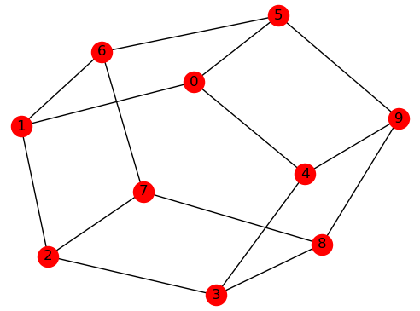
Lecture
SLIDE 7 / 14
Vertex Cover Examples
1
In a triangle graph, any two vertices form a valid vertex cover.
2
The minimum vertex cover for a triangle has a size of two vertices.
3
For a star graph, the single center vertex forms the minimum cover.
4
A path graph of three nodes requires two vertices for a minimum cover.
5
The set of all vertices is always a valid but not minimal vertex cover.
6
An independent set is the complement of a vertex cover in the graph.
7
Checking if a set is a vertex cover takes linear time relative to edges.
Source: docs.dwavequantum.com
Chandigarh University
7 / 14
Notes:
Consider a triangle. You need two vertices to cover all three edges. In a star graph, the center node covers all edges, so the cover size is one. This shows how structure dictates the solution size. Remember, the complement of a vertex cover is an independent set.

Slide 8
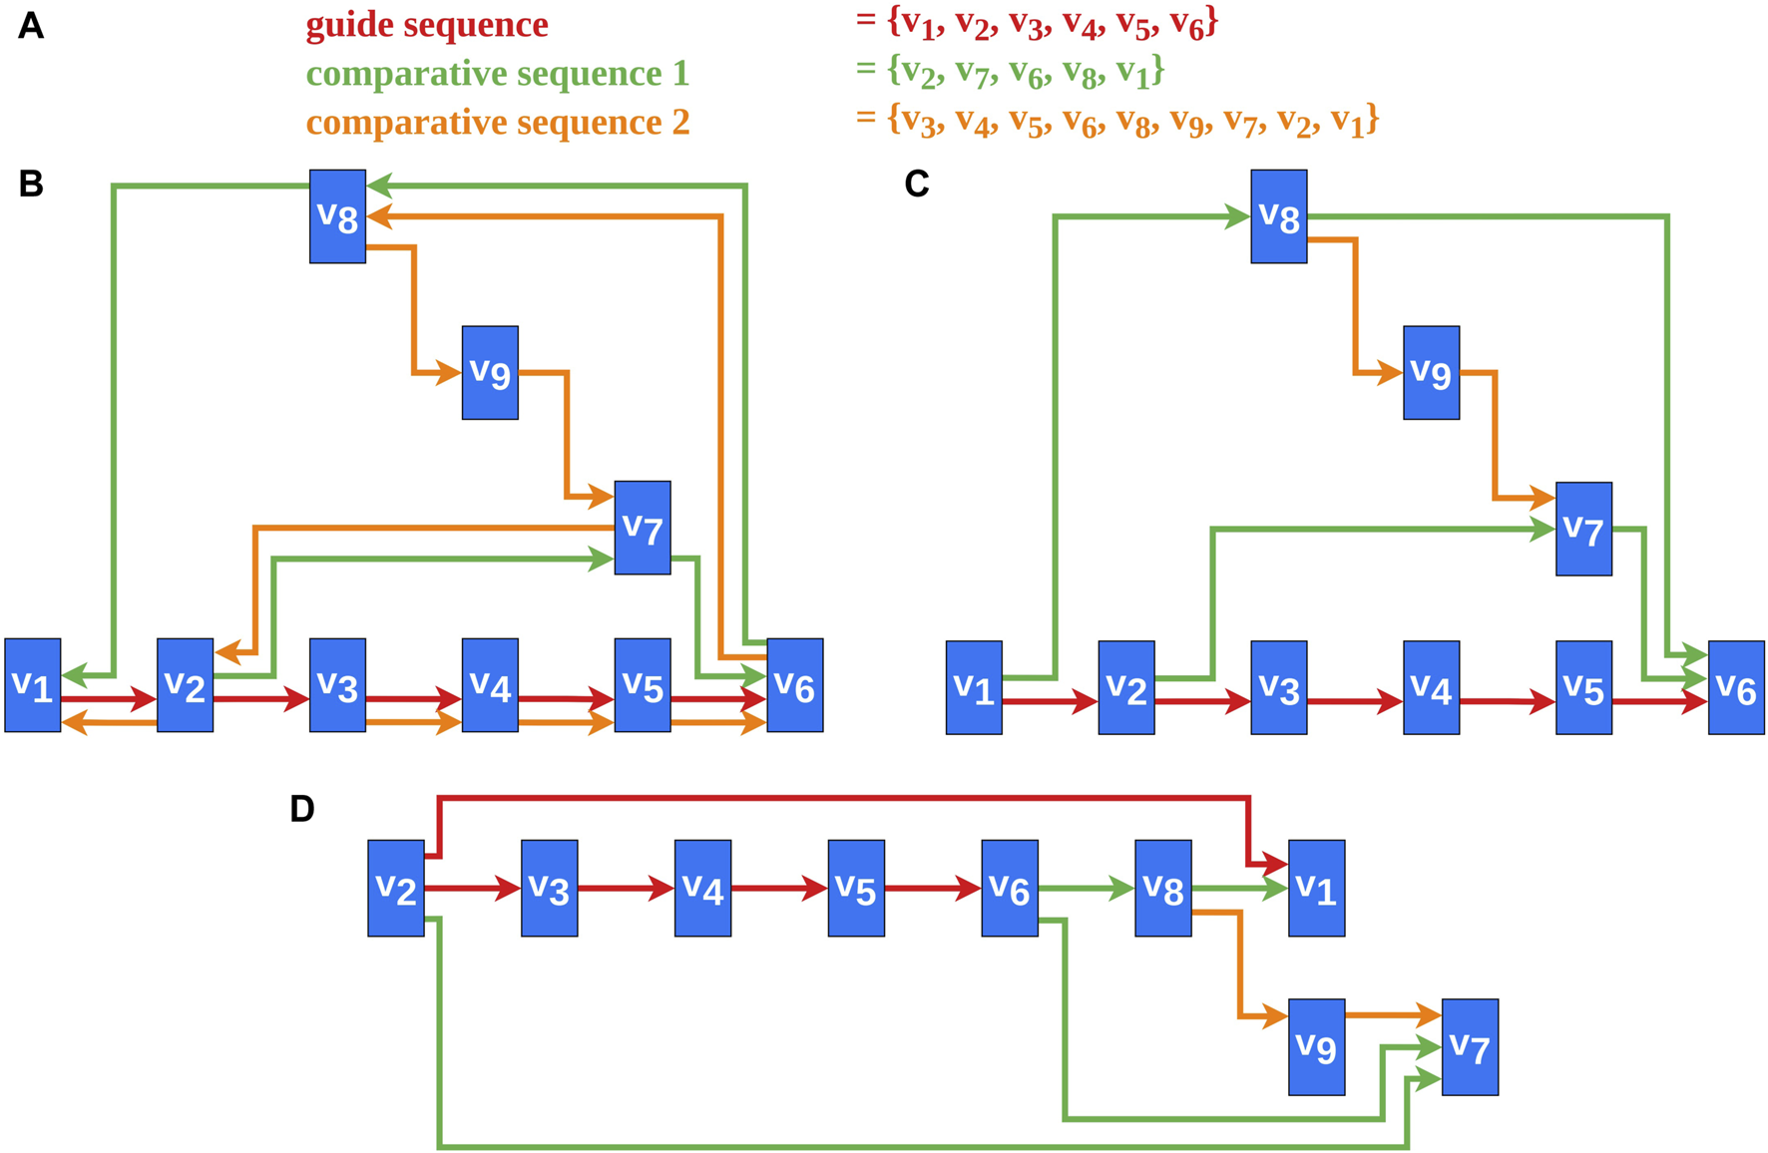
Worked Example
SLIDE 8 / 14
Coloring
1
Consider a graph with vertices A, B, C, D and edges (A,B), (B,C), (C,D).
2
Assign color 1 to vertex A.
3
Vertex B is adjacent to A, so assign color 2 to B.
4
Vertex C is adjacent to B, so assign color 1 to C.
5
Vertex D is adjacent to C, so assign color 2 to D.
6
The resulting chromatic number for this path graph is 2.
7
This greedy approach successfully minimized the colors used for this structure.
Source: www.frontiersin.org
Chandigarh University
8 / 14
Notes:
Let's walk through a path graph. We start at A and give it color 1. B is connected, so it gets color 2. C is connected to B, so it can reuse color 1. D is connected to C, so it gets color 2. We used only two colors, which is optimal for a path.

Slide 9
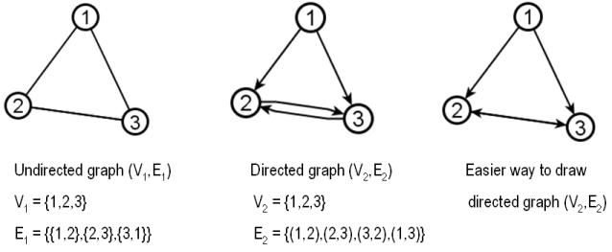
Worked Example
SLIDE 9 / 14
Vertex Cover
1
Consider a graph with vertices 1, 2, 3, 4 and edges (1,2), (2,3), (3,4).
2
Select vertex 2 to cover edges (1,2) and (2,3).
3
Vertex 2 does not cover edge (3,4), so we need another vertex.
4
Select vertex 3 to cover edge (3,4).
5
The set {2, 3} covers all edges in this path graph.
6
The size of this vertex cover is 2.
7
No single vertex can cover all three edges in this specific graph.
Source: cs.slu.edu
Chandigarh University
9 / 14
Notes:
Now for vertex cover on the same path. If we pick vertex 2, we cover the first two edges. But edge (3,4) remains. We must pick vertex 3 to cover that last edge. So {2, 3} is our cover. We cannot do it with just one vertex here.

Slide 10
Lecture
SLIDE 10 / 14
Algorithmic Complexity
1
Determining the chromatic number is an NP-hard problem for general graphs.
2
Finding the minimum vertex cover is also an NP-complete problem.
3
No known polynomial-time algorithm exists for the optimal solution.
4
Greedy algorithms provide approximate solutions in linear or quadratic time.
5
Brute-force search checks all subsets but has exponential time complexity.
6
Approximation algorithms guarantee a solution within a factor of the optimum.
7
Heuristics are often used in practice for large-scale real-world graphs.
Chandigarh University
10 / 14
Notes:
Why do we care about complexity? Because finding the absolute best solution is computationally expensive. These problems are NP-complete, meaning they scale poorly. For large graphs, we rely on heuristics or approximation algorithms that give good, but not necessarily perfect, results quickly.

Slide 11
Common Pitfalls
SLIDE 11 / 14
Coloring
1
Assuming a greedy coloring always yields the minimum number of colors.
2
Ignoring the order of vertex processing in greedy algorithms.
3
Confusing the chromatic number with the maximum degree of the graph.
4
Forgetting that the chromatic number can be less than the maximum degree.
5
Assuming all graphs are bipartite and require only two colors.
6
Overlooking that the chromatic number is always at least the clique number.
7
Treating the problem as solvable in polynomial time for all cases.
Chandigarh University
11 / 14
Notes:
A common mistake is thinking greedy coloring is always optimal. It is not. The order in which you process vertices matters immensely. Also, do not assume every graph is bipartite. Always check for odd cycles before assuming two colors suffice.

Slide 12
Common Pitfalls
SLIDE 12 / 14
Vertex Cover
1
Selecting vertices randomly without checking edge coverage constraints.
2
Assuming the maximum degree vertex is always part of the minimum cover.
3
Confusing vertex cover with dominating set or independent set problems.
4
Failing to verify that every single edge is touched by the selected set.
5
Believing that a greedy approach always finds the smallest possible cover.
6
Ignoring the relationship between vertex cover and independent set complements.
7
Overlooking that the problem is NP-complete and requires approximation.
Chandigarh University
12 / 14
Notes:
Another pitfall is assuming the most connected vertex is always in the optimal cover. Sometimes, picking two less connected vertices is better. Always verify that every edge is covered. Remember, this is not the same as finding a dominating set.

Slide 13
Lecture
SLIDE 13 / 14
Key Takeaways
1
Graph coloring assigns labels to avoid conflicts between adjacent vertices.
2
Vertex cover selects minimum vertices to touch every edge in the graph.
3
Both problems are NP-complete and require heuristics for large inputs.
4
The chromatic number is the minimum colors needed for a valid coloring.
5
Greedy algorithms provide fast but approximate solutions for both problems.
Chandigarh University
13 / 14
Notes:
To summarize, graph coloring avoids conflicts, while vertex cover ensures full coverage. Both are hard problems computationally. We use greedy methods for practical solutions. Remember the definitions and the complexity constraints for your exams.

Slide 14
Lecture
SLIDE 14 / 14
References
DATA STRUCTURES
A Pseudocode Approach with C — Gilberg, Forouzan
• Data Structures — Lipschutz
• Data Structure Using C — AK Sharma
• C and Data structure — P. S. Deshpandey
Chandigarh University
14 / 14
Notes:
These are the standard textbooks for our course. Please refer to the chapters on Graphs for deeper mathematical proofs and additional examples. They provide excellent pseudocode and C implementations for these algorithms. Thank you for your attention.

